Slide 1
Cormant DCIM Solution Partner Session for
Julie Mullins
Stuart Hallin
Paul Goodison
21 April 2014

Slide 2
About
Privately held & profitable
Compound growth over past 4 years at 50 – 85% per annum
25 staff, over 50% in R&D roles.
Released Version 7, Became
“Cormant-CS”
Shifting Market to DC Focus
2010-2011
2013
Founded
Moved World HQ to Calif.
2003
2006-2009
2001
Launched CableSolve
Notes:
Founded 2001 to bring a revolutionary mobile connectivity / infrastructure management product to the market
Infrastructure/Connectivity management on paper or spreadsheets was a terrible idea, Active patch panels were not the solution
Mobility was key
Since launch in 2003 Cormant has been delivering IT infrastructure management to a global customer base
2004 – 2008: Some shift to a focus on DC’s
2013: With the release of version 7 the product name changed from “CableSolve” to “Cormant-CS”

Slide 3
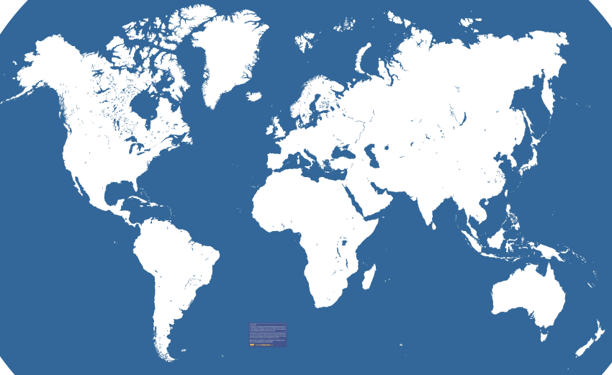
Global Coverage
World HQ,
San Luis Obispo, Calif.
Cormant Coverage
Notes:
HQ in California
Cormant companies in US, UK, Australia, Philippines
Sales & Service Partners in Australia, Canada, Holland, Hong Kong, India, Italy, Ireland, Malaysia, Middle East, Singapore, South America, Thailand, UK, USA
Customers in all these locations (and more)
Ability to deliver global projects with staff and/or partners on 6 continents
Partner engagement works to ensure we support our partners in all locations.

Slide 4
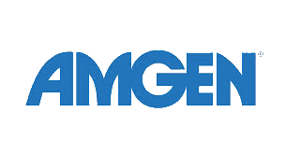
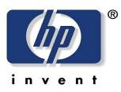
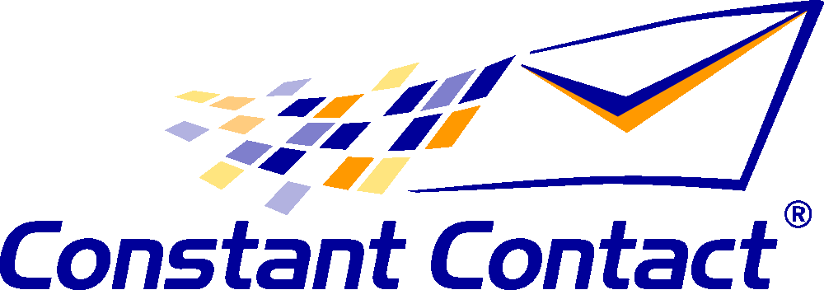
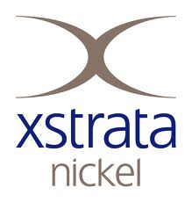
250+ Customers Including
≈80%: Customers purchase additional licenses
>90%: Renewal Rates for annual support & upgrade agreements
Notes:
Sample of customers
Banking / Financial Services: AIG (global), Australian Stock Exchange, Barclays Bank (global), Deutsche Bank AG (global), HSBC, National Australia Bank Group, Lloyds TSB, Coutts
Technology: Cisco Systems, Constant Contact, HP Services, Sony, London Internet Exchange
Government: Canadian Secret Intelligence Service, City of Concord, Department of Defense, Elections Canada, JARIC, Joint Air Reconnaissance, NATO (global), The Foreign and Commonwealth Office
Education: Carleton University, DePaul University, The University of Sydney
Transportation: Melbourne Airport, WestJet
Health: Akron Children's Hospital, Azienda Sanitaria Locale Napoli, CHUM Research Centre, Inspira Woodbury, McKesson Corp.
Also Telecommunications, Pharma, Manufacturing, Energy, Construction
Renewal rates for annual support and upgrade assurance agreements remain over 90% (initial purchase is perpetual license)
A number of customers from 2004 still use CS and renew annually
Approx. 80% of all customers purchase additional licenses as the product footprint expands within their organization
Usually driven by further roll out and additional use within same facilities
Common Customers
Cisco, Amgen, HP, Deutsch Bank, many more?

Slide 5
Server Technology / Cormant
Worked together as part of InteropNet for past 7 shows
Cormant delivers integration to all Server Technology PDUs as a standard part of our DCIM solution
Optional integration to SPM available
When we demonstrate Cormant-CS we always use Server Technology PDU devices
Common Customers

Slide 6
A DCIM Definition
“DCIM encompasses the required infrastructure, equipment, connectivity and environmental information inside and around the data center. DCIM provides a consolidated view of the data; including historical, current and future infrastructure states. It must support processes to assure data is maintained and easy to update. DCIM enables facilities and IT groups to plan together.”
(DCIM should be driven by data center pain rather than a single definition.)

Slide 7
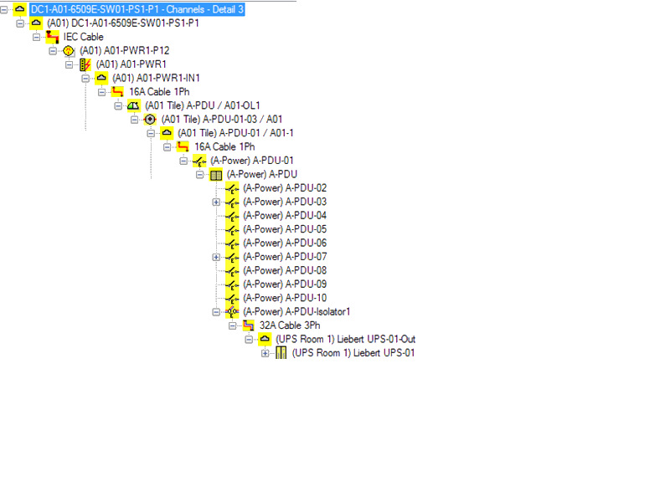
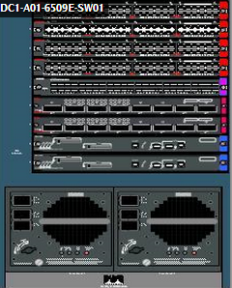
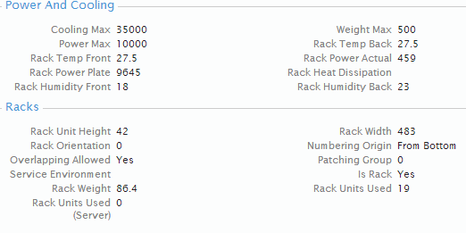
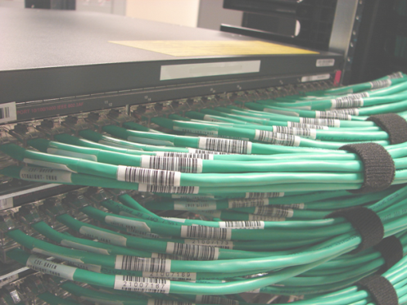
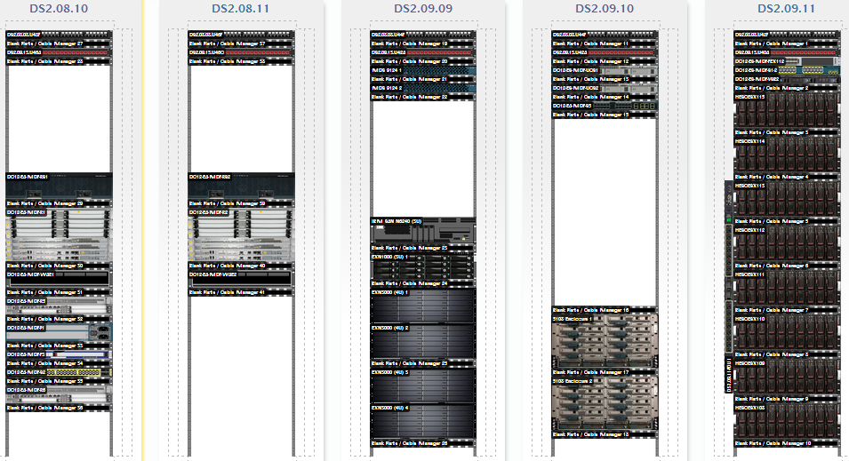
DCIM Difference – Contextualization

Slide 8
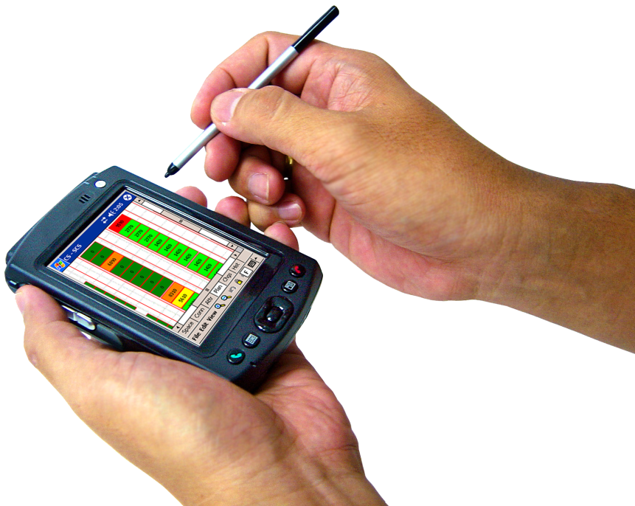
Cormant DCIM Differentiation
Unrivaled product flexibility
Best mobility of any DCIM
Mobility means data stays accurate
Very intuitive user interface
Better initial and continued adoption
Global sales and support coverage
Scalable from 20 racks to 30,000 and beyond
Strong ROI
It’s not ‘cheap’, but price point lower than true competitors

Slide 9
What Industry Analysts Say
Benefits from being a pure-play supplier
No competitive overlap
Background in connectivity management
Solid & full-fledged DCIM
Priced significantly lower
Unique offering within reach of a much larger audience
(Competitors) will be at least two years behind Cormant’s technology
Provides a valuable insight into the power usage within the data center
Notes:
Full quotes:
451 Research: “Cormant competes against much larger rivals in the DCIM market, although it seems to be benefiting from being a pure-play supplier. Unlike large companies that supply DCIM (with the technology being a very small portion of their consolidated revenues), Cormant has no competitive overlap in other datacenter-technology sectors – combined with its background in connectivity management, this has enabled Cormant to attract sizeable resale partners, particularly those that have a datacenter-cabling focus. Cormant is proving to be a competitive supplier.”
IDC: “Cormant comes to the table with a solid, full-fledged DCIM solution that is priced significantly lower than that of other DCIM providers. The lower barrier to entry will motivate many enterprise datacenters to implement DCIM and enables Cormant to benefit from the growing DCIM momentum by coming to market with a unique offering that is within reach of a much larger audience.”
OVUM: “Ovum believes that holistic asset management tools represent a segment of the market that will witness significant growth. We expect more vendors, especially the larger infrastructure management vendors, to introduce similar capabilities, but these will be at least two years behind Cormant's technology initially,” says Ovum Analyst Roy Illsley. “Cormant-CS also provides a valuable insight into the power usage within the data center, which will increasingly become an IT responsibility in many organizations.”

Slide 10
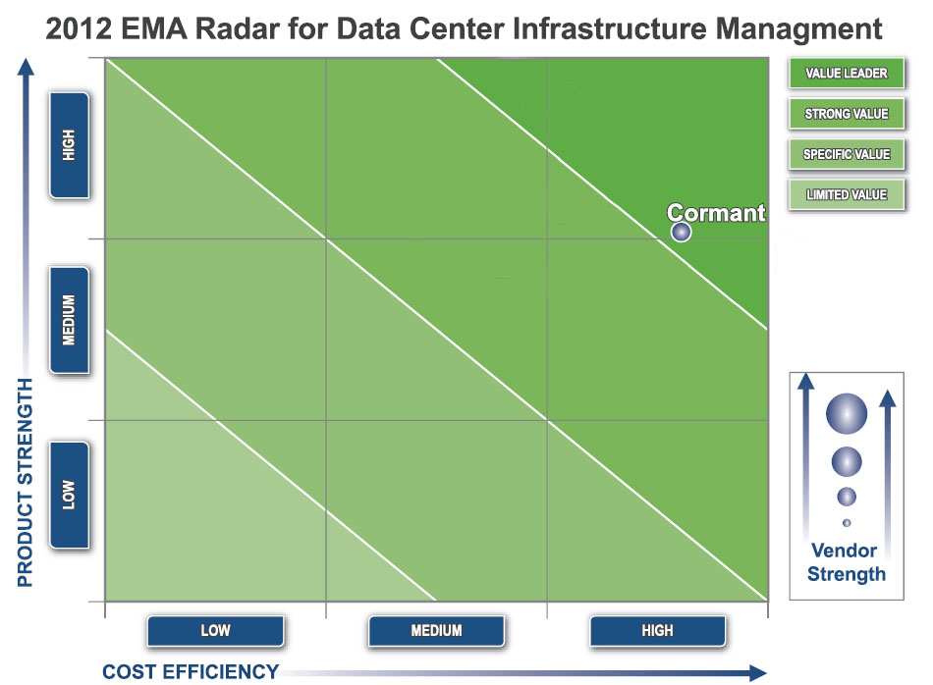
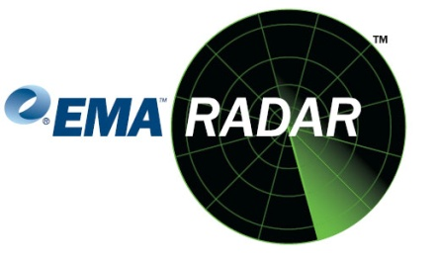
Positioning
Notes:
DCIM: Data Center Infrastructure Management
- A way to visualize IT infrastructure assets and equipment
“Product Strength” axis combines evaluation scores for Functionality with Architecture & Integration.
“Cost Efficiency,” axis is calculated by adding the scores achieved for Cost Advantage and Deployment & Administration.

Slide 11
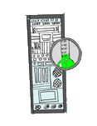
Synergies and Opportunities
DCIM Market penetration less than 15%
Compound growth over 40%
Adds value to PDUs, means data is used
Sold as part of retrofit as easily as part of a new site
Pricing per device ensures cost effective purchase
Together a complete solution to compete against Raritan, Emerson, etc.
Opengear is a common partner for management access
Can provide software to Server Technology as required
Notes:
Seminar ran by Cormant – out of 15 companies, 9 had networked PDUs, only 1 was using the data as part of DC management.

Slide 12
Key Contacts – North America
Paul Goodison
CEO
San Luis Obispo, pgoodiso@cormant.biz, +1 805 776 3476
Julie Mullins
Head of Marketing and Channel Development
San Luis Obispo, jmullins@cormant.biz, +1 805 776 3992
Stuart Hallin
Practice Area Head, Technical Sales
San Luis Obispo, shallin@cormant.biz, +1 805 242 5310
Brad Beamish
Practice Area Head, Deployment
Ottawa/Eastern US, bbeamish@cormant.biz, +1 917 338 2528

Slide 13
http://www.cormant.com/servertech
Address will be up Tuesday 22nd April as single point resource for Server Technology
1 855 CORMANT
sales@cormant.biz

