Slide 1
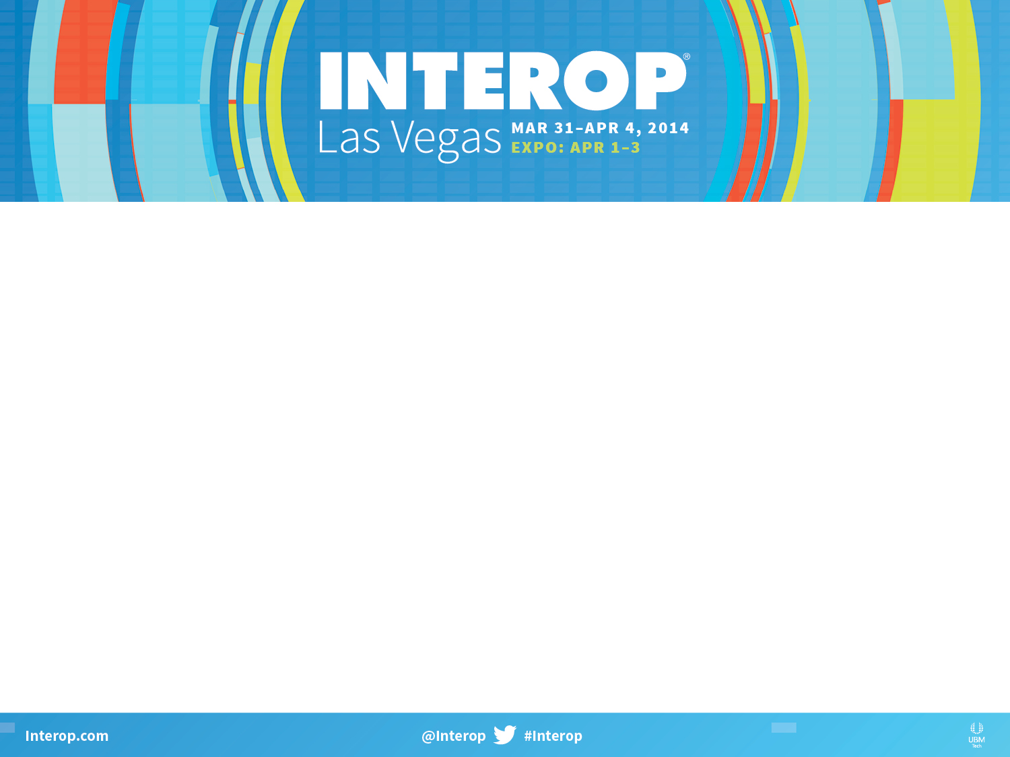

Ensuring a Successful DCIM Project.
What You Need to Know.
Paul Goodison
CEO, Cormant Inc.

Slide 2
Cormant DCIM and Interop

Slide 3
Cormant DCIM
Company
  Founded 2001
  Delivering “Infrastructure Management” Solutions since 2003
  HQ in San Luis Obispo, California.
  Sales in over 20 countries.
Product
  Cormant-CS is our DCIM and Beyond Solution
  Complete DCIM Suite; easy to use due to its very configurable, flexible and straight forward user interface.
Deployments
  Customers range from tens of racks to over 25,000 and include campus and non-DC environments
  Over 250 customers, some going back to 2003

Slide 4

The InteropNet is a temporary network that powers the Interop Las Vegas event, providing a reliable, high-speed network that serves the exhibitors, conference rooms and attendees at the event.
• Up to 260,000 sq. ft. of show floor
• Up to 350,000 sq. ft. of off-show floor
• Three Co-Location Facilities: San Jose, Denver, Newark
• Approximately: 2,000 IT Assets, 18,000 Connections, 90 Wi-Fi AP’s
Over 120,000 Infrastructure Attributes
• Two weeks to stage infrastructure
• Four days to deploy Las Vegas

Slide 5
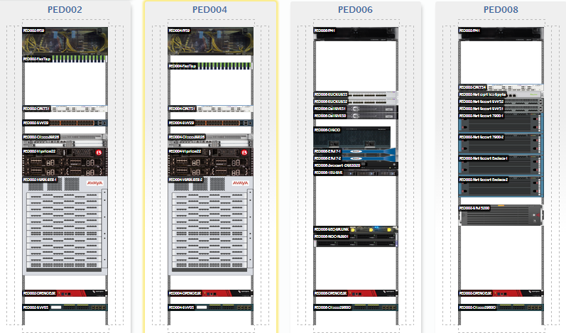
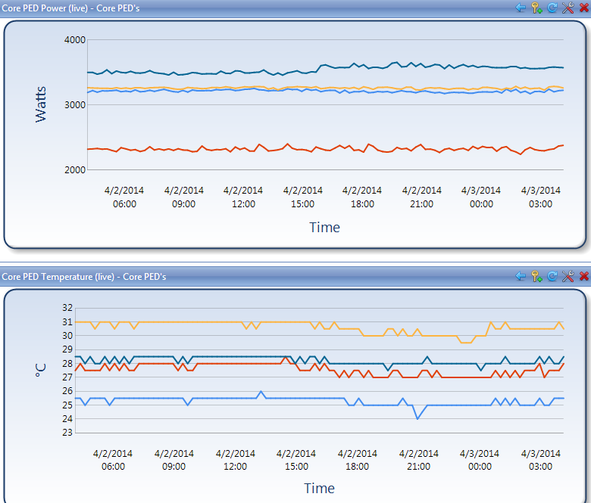
InteropNet and Cormant DCIM
7th Interop Show
Document all assets & racks
Manage physical capacity
Monitor power and temperature in racks
Manage and deliver show floor data network, including all connectivity
Mobile, paperless deployment process and procedure
  Used to be spreadsheet driven
Used for troubleshooting during show

Slide 6
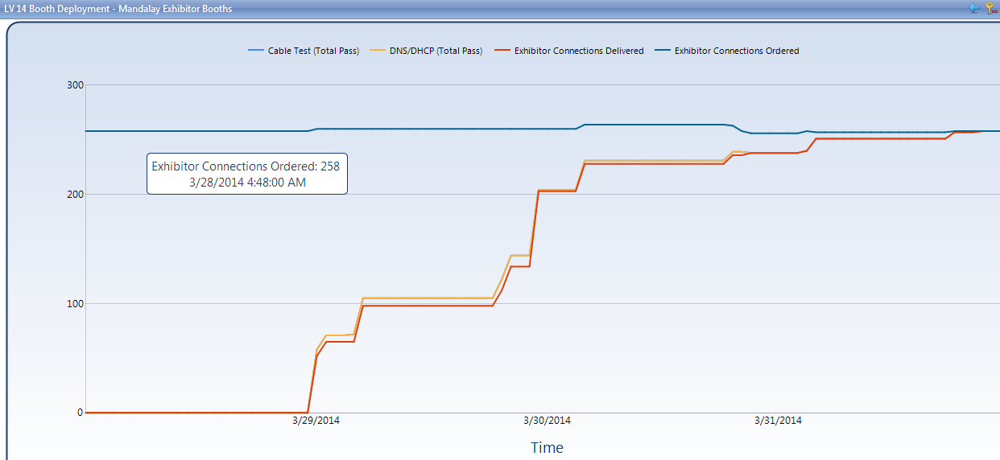
Interop Paperless Deployment

Slide 7
What is DCIM?

Slide 8


Myth - DCIM has one meaning
The term DCIM is subjective in the eyes of analysts, end users and manufacturers.
The term is so broad as to encompass so many different philosophies that apples to apples comparison between vendors is almost impossible.
There is a difference between “DCIM” and “DCIM Enabled” technology. A thermal probe might be DCIM enabled but it is not a DCIM solution on its own.
Over 100 vendors now claiming to be DCIM, but only about 10 vendors offer a true DCIM suite

Slide 9

What is DCIM?
Data Center Infrastructure Management is the practice of Infrastructure Management within the walls of the Data Centre
Many organizations are coming to the realization that the Data Centre infrastructure and assets can not be reliably and efficiently managed with a spreadsheet.
The increased demand for DCIM solutions is driven by 2 major considerations;
Data Centre space is very dynamic, managing change in multiple spreadsheets is inefficient and can become inaccurate.
Data Centre expense in terms of assets and energy represent an ever increasing amount of the available budget.

Slide 10
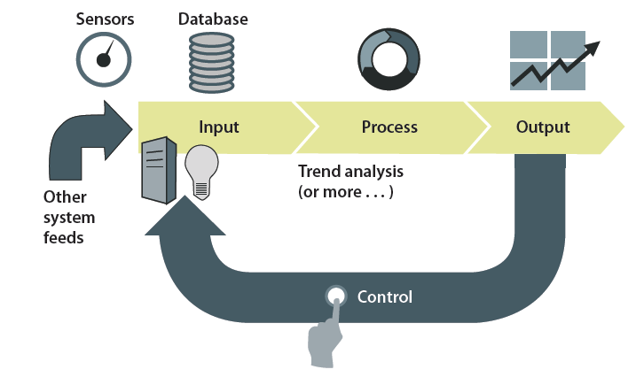
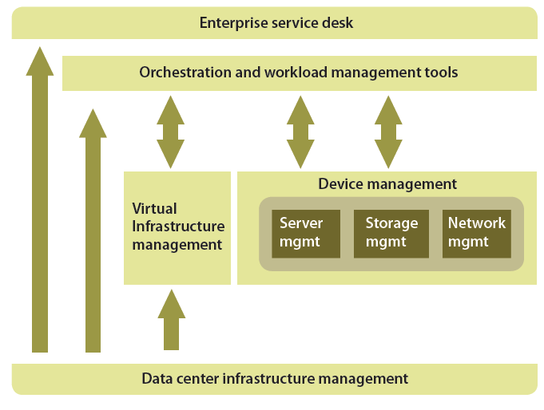
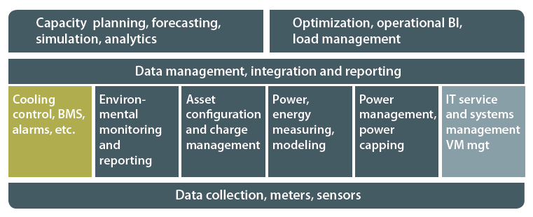
DCIM Models
While many any of the top analyst firms agree that Data Centre Infrastructure Management is crucial to the efficient operation of a complex environment, there is no consensus on the model such a DCIM tool should employ
Gartner
451 Group
Forrester

Slide 11
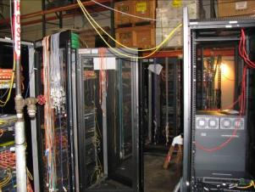
DCIM – not one size fits all
DCIM solutions come in all shapes and sizes, often with specializations, including
  Power
  Asset
  Space
  Connectivity
  Monitoring
  Environmental
  Work management
Some solutions are better suited to specific organizational size from a single site to a global enterprise
DCIM is not a replacement for
  NMS
  BMS
  Ticket system (not entirely)
  Server control
  Load management
  Process management

Slide 12
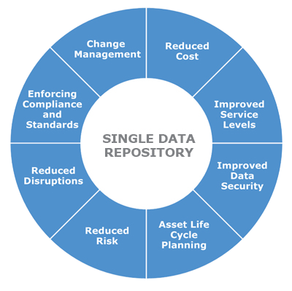
DCIM One System or Many?
Source 451 Group

Slide 13
How to Select a DCIM Solution

Slide 14

DCIM Procurement, Questions to ask internally before you start
Do I understand what problems I want to solve and their priority?
What systems/processes does the DCIM solution need to replace?
Do I have the will to enforce a single process?
What cross department buy-in is there for DCIM implementation?
How good is my documentation of what I have today?
Do I have an understanding of the effort involved in implementation?
Do I want on-going help to manage the solution?
What systems does the DCIM solution need to integrate with?

Slide 15
DCIM Procurement, Questions to ask the DCIM Vendor
Are the current customer base and type similar to yours?
Solution maturity, what version is it?
What parts of my problem set does the solution cover?
What implementation support is available? Ongoing support model?
For a given scope can you provide me a total price for the required software components?
  What additional hardware is required (and cost)?
  Is the Solution “all in one” or modular? Costs for additional modules?
Is mobility built into the solution – tablets, handhelds, etc.?
Is the product configurable (user managed) or require customization (developer managed)?
What interfaces does the solution have?

Slide 16
Start on the DCIM Path
Define your expected DCIM post-implementation process and how you expect to use the solution; share this with vendors
Speak with facilities (M&E), make sure what you are planning does not overlap with their solutions
  And if it does, what is the resolution?
Factor in implementation costs, they can be substantial
Goal
  no XL
  Common understanding of the infrastructure
  Fix your top issues
  A solution to grow with you
Remember: DCIM is not a magic bullet but part of an overall strategy

Slide 17

DCIM Selection Process
RFP process is typical, but keep it realistic!
Is a full version proof-of-concept possible
  This is the best way to kick the tires.
  If it’s not, why not?
Ease of implementation
  A big cost and an understanding of what is possible needs to be part of the decision process.
What is the expected ROI
  How is that derived, do you believe it?

Slide 18
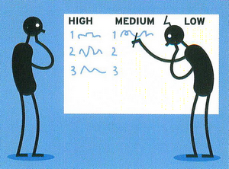
DCIM Proof-Of-Concept Evaluation
Do 2 or 3 solution proof-of-concepts
  Keep scope small and realistic. POCs are time consuming and expensive
  Use some vendor services, but don’t let them run it
  Invest time in the process and involve all stake holders

Slide 19

What you will need to budget for
Software license
On-going upgrade assurance / technical support
Hardware needed?
Process documentation services
Professional services for solution configuration, data import and interfaces
Labor for audit
Solution Training

Slide 20
Implementing and Effectively Using DCIM in your Data Center

Slide 21

What should drive DCIM Implementation
Your Priorities
  The things you defined 6 months ago when this project started
Your Data
  Spreadsheets, etc.
Your Post Implementation Process
  How will you use this solution?
Only manage what your organization requires.
Keep it meaningful.

Slide 22
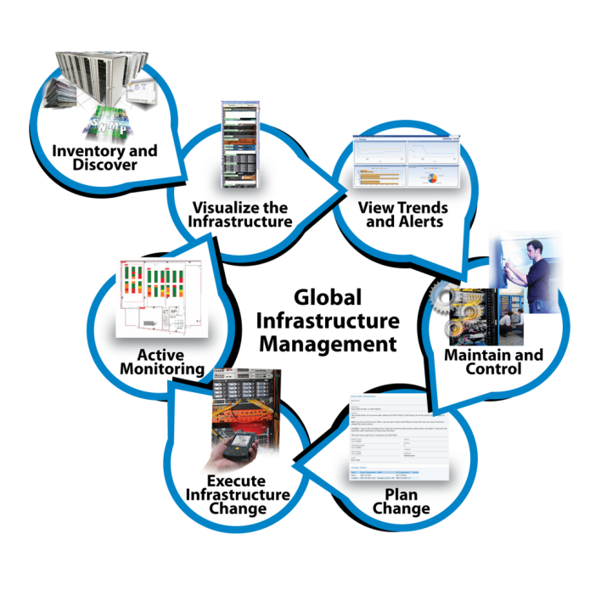
Post Implementation Process
Think about how DCIM needs to be used in the enterprise.
Everyone is different, but using a DCIM tool will require process change.
Defining your to-be process up front will make implementation much easier.

Slide 23
Where to start
Keep the initial deployment simple: Money follows Success
  Don’t get too carried away with size, focus on solving some real problems
Think Small (that may be 1,000 racks!) and geographically limited
Look ahead: What areas may become issues in the future?
  Equipment refresh
  Power
  Data center move
  Consolidation, virtualization
  Mergers and acquisitions
  Green initiatives
Think across the enterprise

Slide 24

DCIM Deployment
Use the post implementation process to drive deployment
  How will the infrastructure be maintained
Use outside help to get going
  Most people are too busy with the day to day
Import existing data and then use audit to confirm it
Use a maturity model approach
  Get control of what you have
  Start to monitor
  Use the data for analysis and diagnosis

Slide 25
Why DCIM Implementations Can Fail

Slide 26
It’s NOT Just Software
DCIM SUCCESS =
SOFTWARE + PROCESS + MATURITY

Slide 27

DCIM Implementation Pitfalls to Avoid
Too broad an initial project scope
Collecting data that is of no use
Expecting DCIM to solve problems without recognizing that process change is vital
Choosing a solution that requires developer customization to be useful
Not being clear on precisely how you intend to use the solution
Not getting external implementation help

Slide 28
Disappointment: DCIM Myths
“Your power bill will drop 20% once you have installed a DCIM tool.”
  Unlikely, You will find savings and efficiency gains, but will offset them with growth.
“Once you have implemented a DCIM solution your records will be perfect – all the time.”
  Something like 30% of the success of any DCIM solution is process change/enforcement. Often missed entirely.
“DCIM tools don’t need to be bought with services to implement them and really auto-discovery will do most of the work.”
  Implementation by a professional, experienced company (that may not be the software vendor) is vital to make DCIM work. Big area of disappointment.
  Auto discover is at best a validation tool, it’s not going to document most of your physical infrastructure, especially where things are.

Slide 29
Ensure DCIM Success

Slide 30

Ongoing Success
Stabilize the initial deployment scope
Fix issues
Refine processes
Plan further deployments
Once initial goals have been achieved look to a phase two; what other problems can we solve?

Slide 31

DCIM: What Works?
What really works with DCIM?
Simplicity - Aids adoption within core group, makes training easy, allows for turnover, further adoption as success is demonstrated
Accessibility - If it’s easy to get access to the data, it’s far more likely to be used. Avoid solutions that license in a per seat or per session model. Seek solutions that include mobility.
Standardized - Customization makes upgrades difficult and expensive
Flexibility - The solution should be able to scale up as the organization grows and makes acquisitions
Vendor agnostic – Avoid products that only work with specific manufacturer’s hardware, the ideal DCIM solution will document all infrastructure regardless of manufacturer
Just enough management - Solve the biggest problems first
DCIM Success = Software + Process + Maturity

Slide 32
Thank you
Paul Goodison,
Cormant Inc. Booth 1363
Tel: +1 805 776 3476 pgoodiso@cormant.com

