Slide 1

Session TRD 4
Why Aren’t You Using DCIM?: Exploration of the Pros and Cons of DCIM
Presenter: Paul Goodison, CEO
Cormant, Inc.
Notes:
Paul Goodison
pgoodiso@cormant.biz
Tel: 1 855 CORMANT

Slide 2
Session TRD 4
Why Aren’t You Using DCIM?: Exploration of the Pros and Cons of DCIM
Oct. 20, 2014; 10:20 – 11:20am
The explosion of DCIM offerings from vendors, DCIM definitions from analysts, and DCIM media coverage can leave people wondering what DCIM is and question how they might successfully select and implement a solution for the long term. This session will cover how to choose the most appropriate DCIM solution for your unique goals, what it takes to use DCIM to manage your data center effectively, and why DCIM implementations don’t always deliver on the initial promise.

Slide 3
DATA CENTER CHALLENGES AND CHANGES

Slide 4
Problems in the Datacenter – last 12 months
% of respondents
N = 401
Source: Koppy, Jennifer, IDC. “What IT Managers Want from DCIM: Results of IDC’s 2013 Datacenter Survey” March 13, 2014.

Slide 5

Data Center Challenges
Pressure to deliver new applications / service more rapidly
Move to virtualization or software defined data center
Mixed data center models of owned and third partly co-lo sites
Lack of information or standard workflow
Reduce outages, reduce Capex, improve Opex
Communication challenges between IT and Facilities

Slide 6
WHAT IS DCIM?

Slide 7
DCIM Definition - 451
DCIM enables managers to track & analyze information about a datacenter’s operational status, assets & resource use (space, power, cooling, connectivity)
DCIM systems analyzes this information in ways that help managers meet business & service-oriented goals & to optimize a datacenter’s performance
Source & © 451 Research 2014

Slide 8
DCIM Definition - Gartner
Gartner defines DCIM as tools that monitor, measure, manage and/or control data center resources and energy consumption of both IT-related equipment and facilities infrastructure components. DCIM tools are data-center-specific, rather than general building management system (BMS) tools, and are used to optimize data center power, cooling and physical space. Solutions do not have to be sensor-based, but they do have to be designed to accommodate real-time power and temperature/environmental monitoring and support resource management, as well as have the reporting and visualization capabilities necessary to analyze the data collected in ways that are meaningful to several constituencies, such as DC operators and managers, facility managers and C-level executives. In addition, DCIM solutions may also include other functionality, such as predictive analysis, modeling/simulation, airflow and pressure monitoring, and related capabilities.
Source & © Gartner 2014

Slide 9


DCIM
“DCIM encompasses the required infrastructure, equipment, connectivity and environmental information inside and around the data center. DCIM provides a consolidated view of the data; including historical, current and future infrastructure states. It must support processes to assure data is maintained and easy to update. DCIM enables facilities and IT groups to plan together.”
Infrastructure
Equipment
Connectivity
Environmental information
(DCIM should be driven by data center pain rather than a single definition)

Slide 10
DCIM BENEFITS

Slide 11
Spreadsheet Management vs. DCIM

Slide 12
IDC Survey - Ranking of DCIM Benefits
Create a link between spending on IT and business value
Reduce spending on energy
Providing data to management team
Workflow management
Keep track of assets
Calculating PUE
Faster deployment of assets
Based on mean importance ratings based on a scale of 1 to 5 with 1 = not at all important and 5 = very important; N = 401
Source: Koppy, Jennifer, IDC. “What IT Managers Want from DCIM: Results of IDC’s 2013 Datacenter Survey” March 13, 2014.

Slide 13
451 - What Does DCIM Really Do?
DCIM Enables Manager to:
Understand the overall performance of a facility
Visualize & compare power usage vs capacity vs provisioning
Determine actual cooling requirements
Visualize assets, connections & requirements
Spot anomalies, emerging issues
Plan for new equipment & understand requirements
Determine capacity requirements today & in the future
Source & © 451 Research 2014

Slide 14
DCIM – REASONS NOT TO INVEST

Slide 15
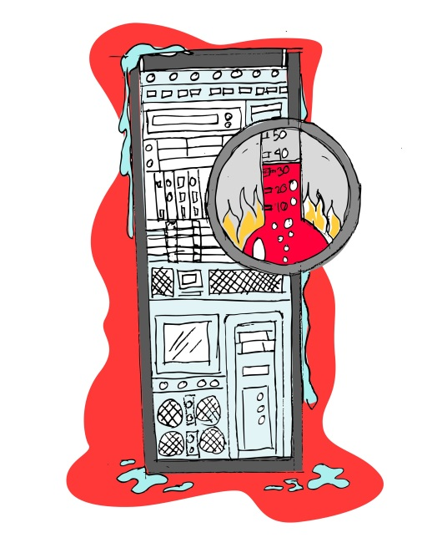
Reasons not to invest in DCIM?!
DCIM is an immature market
Too many solutions
Confusing offerings
Not proven
No budget / no ROI
Too hard to implement
Process change would be impossible in my organization
No need I know what is going on in the DC
I love my spreadsheets!
I like my racks looking like this one!

Slide 16
SELECTING A DCIM SOLUTION

Slide 17
DCIM Selection
Set your solution goals
Consider your current & future DC models
Evaluate DCIM professional service offerings
Look for pilot or phased options
Contact customer references
Notes:
When to select? Well any time really, retrofit possible.
Before evaluating DCIM tools, document what you want to accomplish with them.
Consider where your DC resources will be in 3 years or so.
Realize that your organization – even very hands on help need implementation support
Select solutions that will allow a pilot or phased purchase to ensure the solution is right for you.
Take up references, just because ACME Co. has the solution does not mean they like it!

Slide 18
Gartner – DCIM selection advice
Understand what DCIM's various capabilities really are, and determine how they align with your organization's specific needs.
Study the technical implementation details of your shortlist vendors to ensure you understand how they achieve what they claim to do.
Probe beyond the technical implementation to understand the solution's modularity; scalability; openness; startup complexity; level of integration that has already been done, versus what will be required; degree of training required; and delivery models.
Focus on your specific requirements, and look for the best match.
Consider the supporting processes that will be needed both before and after implementation, and train your staff accordingly.
Source & © Gartner 2014

Slide 19


Selection Process Example
Limitations
Requirements
Power/env. management
Capacity management
Asset/equipment management
Plan/change/workflow
Services
Connectivity management
Workflow management
Mobility
Analytics/Reporting
Interfacing Capability
Phased Rollouts
Vendor A
Vendor B
Vendor C
Vendor D
Vendor E
Vendor F
Vendor G
Vendor H
Identify
Rank
Match vendor
1
3
2
1
2
Requirements and Limitations
1
2
Process
2
2
1
1
3
3
2
Notes:
As mentioned before, you start with your goals. This leads you to your DCIM requirements and limitations which will help you in your vendor selection process.
First, you identify the key requirements you’re looking for with DCIM. You need to consider these requirements with internal limitations such as your budget vs the cost of the DCIM solution as well as time to implement when deciding how many requirements you’d like to tackle up front.
You then rank the requirements based on what’s most important to you and given a budget, which features are necessary.
Once you have these ranked, you take your pool of vendors and begin narrowing the list.
Take your necessities first, these are your most important reasons for deploying DCIM and see which vendors satisfy these criteria.
Then look at your 2nd tier priorities and narrow your list further, also keeping your limitations in mind as some vendors may be out of the price range at your 1st tier priorities whereas others may not be, for example.
Then look at your 3rd tier and so on until you achieve a manageable shortlist to do demos and possibly even a proof of concept prior to implementation. Sometimes a demo is enough, but a proof of concept can often help you validate what the vendor is telling you.

Slide 20
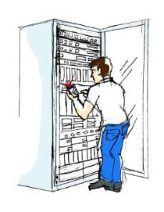
IMPLEMENTING A DCIM SOLUTION

Slide 21
Initial DCIM Deployment Process
Training for Ops and Admin Staff
Process Documentation and Delivery (Live)*
Implementation Training / Consulting
System Configuration / Initial Site
Data Import / Load
Analytics*, Data Validation / Physical Audit
Monitoring & Interfaces*
* Likely phased

Slide 22
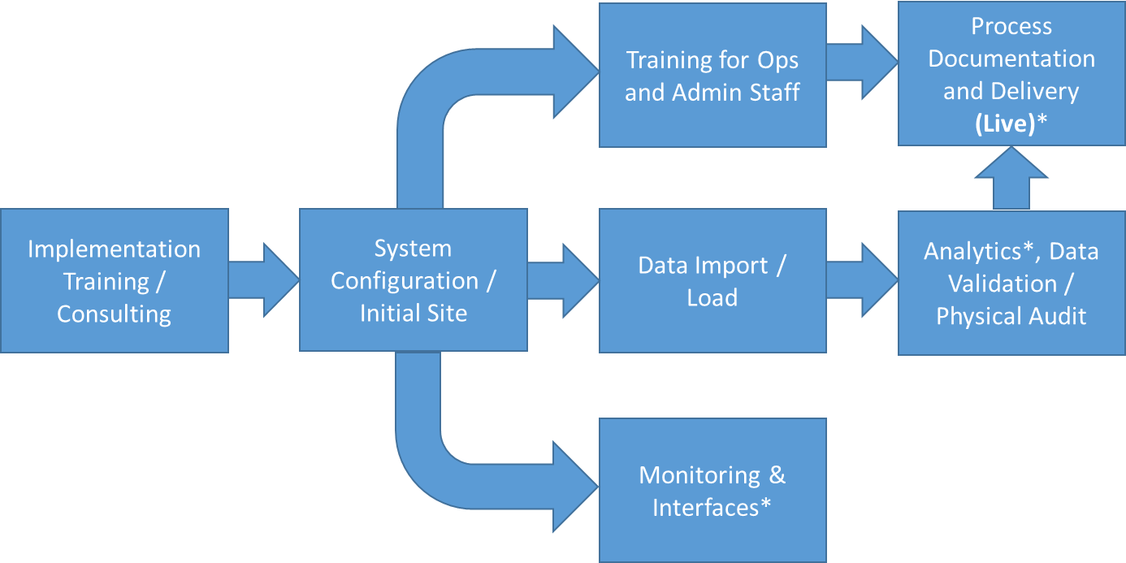
What to Expect?
Make sure budget and ambition
match
Get help - even DIY DC’s
  Mistakes are expensive!
Your data is not as good as you think!
Some people won’t be happy
Scope: be realistic, this is a journey
It can be hard to be successful

Slide 23
Planning the initial site
Limit initial scope in breadth and in geography
  Money follows success
Define who will use the system, work back from there:
  Outputs required
  High level work processes
  Interfaces & Monitoring (sensors)
  Document system config needs
Confirm data sources, be honest about quality
  Physical audit requirements?
Configure:
  Data elements, equipment in environment & template, security, etc.
  Include planned interfaces and monitoring
Implementation Training / Consulting
System Configuration / Initial Site

Slide 24
The Tricky Bits
Training for Ops and Admin Staff
Data import can take a significant amount of planning
  Often once imported you will be live
  Only import (and plan to collect) data that is actually useful
Training needs to happen to ensure everyone is ready.
  Implementation plans drive who needs training
Keep monitoring and interfaces to a minimum at first since they are more complex than they appear.
Data Import / Load
Monitoring & Interfaces*

Slide 25
Going Live
Success or possibly months of problems depend on how well people are trained and how integrated DCIM is into the site processes.
Reporting and other outputs are refined and used
  Visible use keeps people honest
Data quality often requires physical audits
  But is not an excuse not to be live
Process Documentation and Delivery (Live)*
Analytics*, Data Validation / Physical Audit

Slide 26
THE DCIM JOURNEY

Slide 27
DCIM Ecosystem Interfaces

Slide 28
DCIM Journey – Rollout to sites
Training for Ops and Admin Staff
Refine Process Documentation Deliver site Live*
Roll Out Planning
Refine System Configuration
Site Data Import / Load
Refine Analytics*, Data Validation / Physical Audit
Site Monitoring
* Likely phased
Notes:
Roll out to further sites
Inevitably there will be assumptions to correct, mistakes made, missed data, irrelevant data, process improvement, site differences.
Make them now before enterprise rollout (and retrofit to pilot site first)
Update system and move forward.

Slide 29
DCIM Journey – After Rollout:
Optimization & Expansion
Update Process Documentation
And Repeat
Identify & Prioritize Additional Problems
System Configuration Update
Interfaces & Additional Monitoring
Refine Analytics, Data Validation
Examples:
New Problems to be solved
DC optimization
Additional Infrastructure Control

Slide 30
DCIM – WHAT CAN GO WRONG

Slide 31
451 – DCIM End User Challenges
DCIM asset, change and configuration management systems
  Populating the asset database
  Maintaining the accuracy of the asset database
  Process change (i.e., new internal operational/business processes or changes were required to implement the system)
DCIM monitoring, reporting and analysis systems
  Integration issues with existing systems and/or external data
  Inadequate data reporting
  Technical bugs/failures
Source: 451 Research DCIM End-User Survey 2014, N=100
Notes:
Two thirds of users cited maintaining the accuracy of their product's asset database as their top challenge. (It was also the top barrier to DCIM deployment in Uptime’s 2013 survey)
Almost half reported that process change was a significant challenge (will require closer alignment of IT and Facilities department than many organizations currently have).
By far, integration got the most votes as most challenging, as well as most votes overall.
Users with suites also cited “time it took to deploy” as a significant challenge.

Slide 32

Enterprise Challenges Causing DCIM Failure
Complexity of silos within IT/DC infrastructure
Data integrity
Long implementation cycles
Unclear intent of use
No designated DCIM leader

Slide 33

DCIM Solution and Process Failure
Project scope is too broad
Collecting useless data
Relying on DCIM to ‘solve’ problems without internal process change
Not getting external implementation help
Not following best practice advice

Slide 34
DCIM SUCCESS & SUMMARY

Slide 35
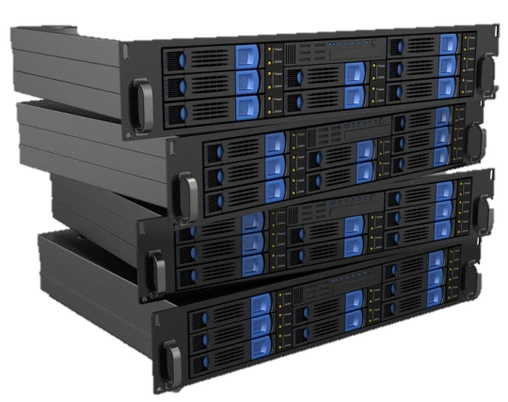


Example of DCIM Success
Removed or freed in 2 years:
Nearly 15,000 physical servers
20,000 network ports
3,000 storage area network ports
Saved:
$7.9 Million on electricity (5.5MW power)
$2.1 Million on legacy maintenance costs
Saved $10 Million in 2012 – 2014
Removed or freed in 1 year:
586 physical servers
Saved:
$734, 550 on electricity (931kW power)
Saved $734,550 in 2012- 2013
Source: Booth, Nick. “Barclays Saves US$6M By Weeding Out Dead Servers.” Datacenter Dynamics, 13 May 2014.
http://www.datacenterdynamics.com/focus/archive/2014/05/barclays-saves-us6m-weeding-out-dead-servers.
Notes:
Barclays has saved a significant amount of money by using DCIM software for monitoring of items.

Slide 36
451 Research – DCIM Summary
Choose DCIM to manage your datacenter today & tomorrow
DCIM is a journey, deploy features over time
DCIM is not an island … it will need to be integrated
Develop best-practices in tandem with DCIM
Datacenters are becoming more dynamic, more complex – consider DCIM as necessary for efficiency, availability & agility …
Source & © 451 Research 2014
Notes:
36

Slide 37

DCIM - What Really Works?
Simplicity – Eases adoption and training, increases use and allows for staff turnover.
Accessibility – Increases likelihood of use.
*Avoid solutions that license in a per seat or per session model.
*Seek out solutions with mobility for enhanced accuracy.
Process Integration – Ingrain the DCIM solution in the DC processes so the data will stay relevant and therefore used long term.
Flexibility – Ability to scale and grow with the organization.
The best solution for you – Don’t only consider solutions from
vendors you use today.
Interfaces – DCIM is not monolithic, but part of an ecosystem.
Just enough management – Solve the biggest problems first.

Slide 38
A final word on long-term DCIM success
“The most-critical component of all DCIM solutions is the viability of the data, and as such, the key success factor for long-term DCIM benefits is tight integration between creating the asset dataset, and keeping it up to date. This implies not only strong import and integration tools between existing processes, but also automated discovery of new assets and, most importantly, a tight linkage into the change management process to ensure that all changes, of any kind, get updated to the dataset automatically. Without that, the initial euphoria of a DCIM product's benefits will dwindle rapidly. Training prior to installation is important, but ongoing training is even more critical after the initial implementation team goes back to their normal jobs.”
Gartner: Best Practices: Optimize Your Data Center Utilization With DCIM
Source & © Gartner 2014
Notes:
Gartner: Best Practices: Optimize Your Data Center Utilization With DCIM
13 August 2014 G00267307
Analyst(s): April Adams | David J. Cappuccio

Slide 39

SOFTWARE
+ PROCESS
+ MATURITY
= DCIM SUCCESS
Paul Goodison, CEO, Cormant Inc.
pgoodiso@cormant.com
Notes:
Paul Goodison
pgoodiso@cormant.biz
Tel: 1 855 CORMANT

Slide 40
DCIM Procurement
Questions to ask your organization before you start
Do we understand what problems we want to solve and what are our biggest problems today?
How good is our documentation of what we have today?
Do we have the will to enforce a single process?
What cross department buy in do we have or need?
What is the cost of inaction, can we keep doing things with a spreadsheet?
What DC initiatives are coming up?

Slide 41
DCIM Procurement
Questions to ask the DCIM Vendor
What parts of my problem set does the solution cover?
Current customer base and type; are they similar to you?
What implementation support is available?
Is mobility built into the solution – tablets, handhelds, etc.?
What additional hardware is required?
How configurable is the product (user managed)?
How will the solution scale?
What interfaces does the solution have?
What is the support model?
Solution maturity, what version is this?
Road map, where is the solution going?

